Slide 1


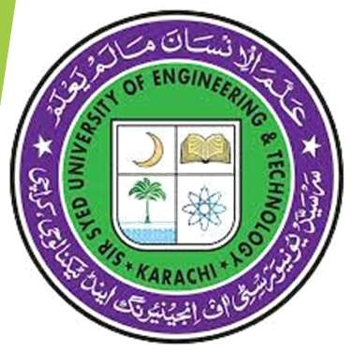
1st Chapter
Articles of Faith in Islam
Iman e Mujmal and Iman e Mufassal
Oneness of Allah Angels
Revealed Books
Ms. SAFIA WAQAS
Session: Spring: 2025
Course: Islamic Studies / Ethical Behavior

Slide 2
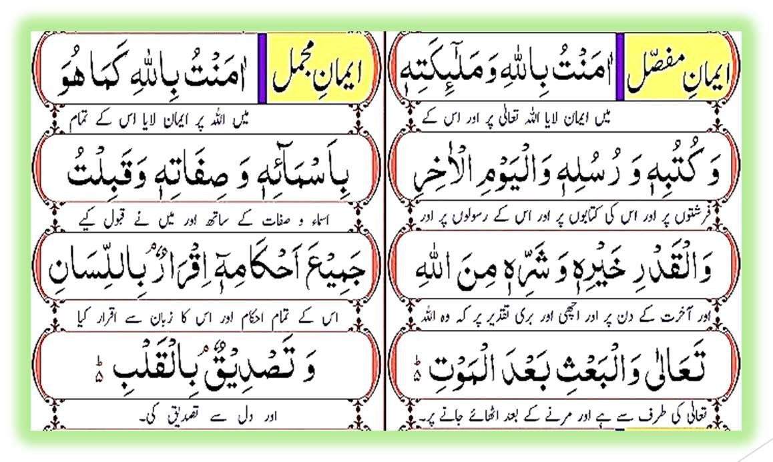
Iman-e-Mujmal & Iman-e-Mufassal
Iman-e-Mujmal (Brief Faith):
“I have faith in Allah as He is with all His Names and Attributes, and I accept all His commands.”
Iman-e-Mufassal (Detailed Faith):
“I believe in Allah, His Angels, His Books, His Messengers, the Last Day, and in Destiny, that all good and bad is from Allah, and in the resurrection after death.”

Slide 3
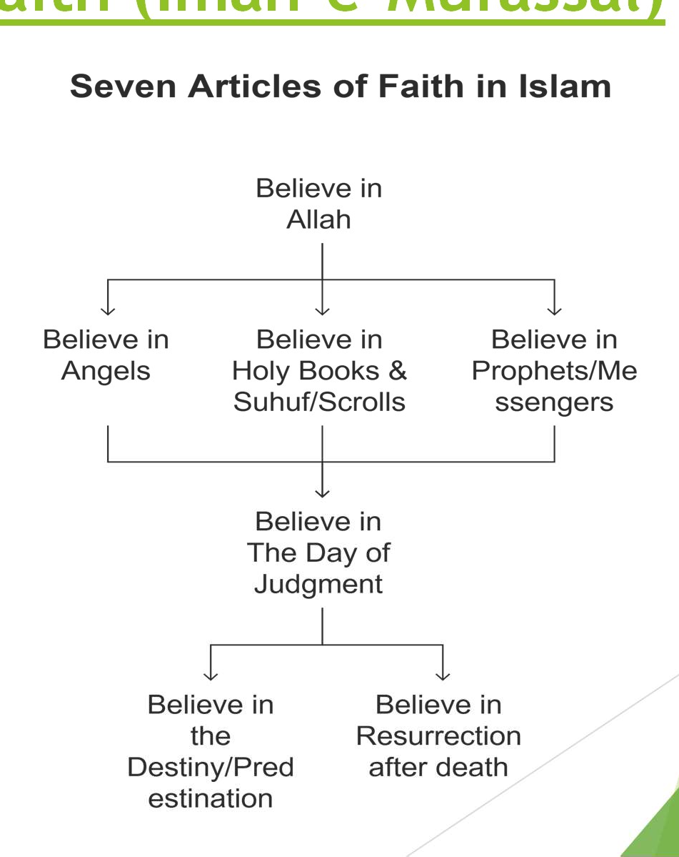
Seven Articles of Faith (Iman-e-Mufassal)
Belief in Allah (Tawheed)
Belief in Angels
Belief in Divine Books
Belief in Prophets and Messengers
Belief in the Day of Judgment
Belief in Destiny (Qadar)
Belief in Resurrection after Death

Slide 4
Seven Articles of Faith (Quarn & Hadith)
Belief in Allah (Tawhid)
Definition: Believing in one true God, Allah, who is the sole creator, sustainer, and ruler of the universe.
Quran: “There is no god but Allah” (Quran 47:19).
Prophet says: Prophet Muhammad (pbuh) consistently taught that all worship must be directed solely to Allah.
2- Belief in Angels
Definition: Believing that angels are spiritual beings created from light who obey Allah and perform tasks like delivering revelations and recording deeds.
Quran: “And whoever disbelieves in Allah, His angels, His Books, His Messengers, and the Last Day has certainly gone far astray(losing the right path or making big mistakes)” (Quran 4:136).
Prophet: The Prophet (pbuh) received the Quran through the angel Jibril (Gabriel).
3- Belief in Divine Books (holy books sent by Allah (God) to guide people)
Definition: Believing that Allah revealed holy books to guide humanity, including the Quran(Hazrat Muhammad PBUH), Torah (revealed to Prophet Musa AS, Gospel (Injil, revealed to Prophet Isa AS), and Psalms (Zabur, revealed to Prophet Dawud AS).
Quran: “We have sent down to thee the Book in truth, confirming the scripture that came before it” (Quran 3:3).
Prophet: Prophet Muhammad (pbuh) conveyed the Quran as the final and perfect revelation.
Sahaba: The Sahaba memorized and recited the Quran, preserving its guidance for future generations.

Slide 5
Belief in Prophets and Messengers
Definition: Believing that Allah sent prophets and messengers to guide humanity.
Quran: “We have sent thee inspiration, as we inspired Noah and the prophets after him” (Quran 4:163).
Prophet Example: Prophet Muhammad (pbuh) stressed that all prophets taught the same message of worshiping one God.
Belief in the Day of Judgment
Definition: Believing that a final day will come when every soul is resurrected and judged by Allah based on its deeds.
Quran: “Every soul shall taste death; then to Us you shall return” (Quran 29:57).
Prophet: The Prophet (pbuh) warned his followers to prepare for this day by living righteously.
Belief in Destiny (Qadar)
Definition: Believing that everything happens by Allah’s will and is part of His divine plan, while humans are still responsible for their choices.
Quran: “And you do not will except that Allah wills” (Quran 76:30).
Prophet: The Prophet (pbuh) encouraged striving for good while trusting in Allah’s decree.
Belief in Resurrection (coming back to life after death)”
Definition: Believing that after death, all souls and bodies will be revived for final judgment by Allah.
^{Ms}o^{Safia}Q^{Wa}u^{q}r^{as}a⁻n^{Sp}E^{rin}x^{g}a²m⁰²⁵p^{Is}l^{l}e^{am}: ^{i}“^{c}A^{St}n^{ud}d^{ies}t/h^{E}e^{thi}T^{c}r^{al}u^{B}m^{eha}p^{vi}e^{ou}t^{r} will be blown, and all who are in the heavens and all who are ⁵on earth will be terrified” (Quran 39:68).

Slide 6
Introduction to Articles of Faith in Islam
Definition of Iman (Faith):
Iman Means:
Acceptance (Tasdiq) of Allah’s truth. Conviction (Yaqin) in His message Commitment (Iltizam) to follow His laws Surrender (Taslim) to Allah’s will.
Which things are involves in our Iman?
Heart: Believing in Allah and His message.
Tonge: Declaring faith through the Shahada (declaration of faith).
Actions: Practicing Islam's teachings and obligations.

Slide 7
Impact of Iman on Ethical Behavior
Guides Our Actions:
Iman shapes how we behave at home, work, and in society.
Prophet Example: Prophet Muhammad (pbuh) always acted with honesty and fairness, even in difficult situations, guiding his community by example.
Builds Moral Character:
Iman encourages traits like honesty, compassion, and fairness.
Sahaba Example: Abu Bakr (RA) was known for his selflessness and kindness—he shared his wealth to help those in need, reflecting true moral character.
Provides Accountability:
Iman reminds us that every action is recorded and will be judged by Allah.
Prophet Reminder: The Prophet (pbuh) taught that angels record our deeds, urging us to act justly, much like school rules that hold us accountable.

Slide 8
Believe in Allah – The Oneness of Allah (Tawheed)
◆ Topics:
◆ Concept of Tawheed
◆ Tawheed According to Surah-e-Ikhlas
◆ Categories of Tawheed
◆ Types of Shirk
◆ Importance of Tawheed:

Slide 9
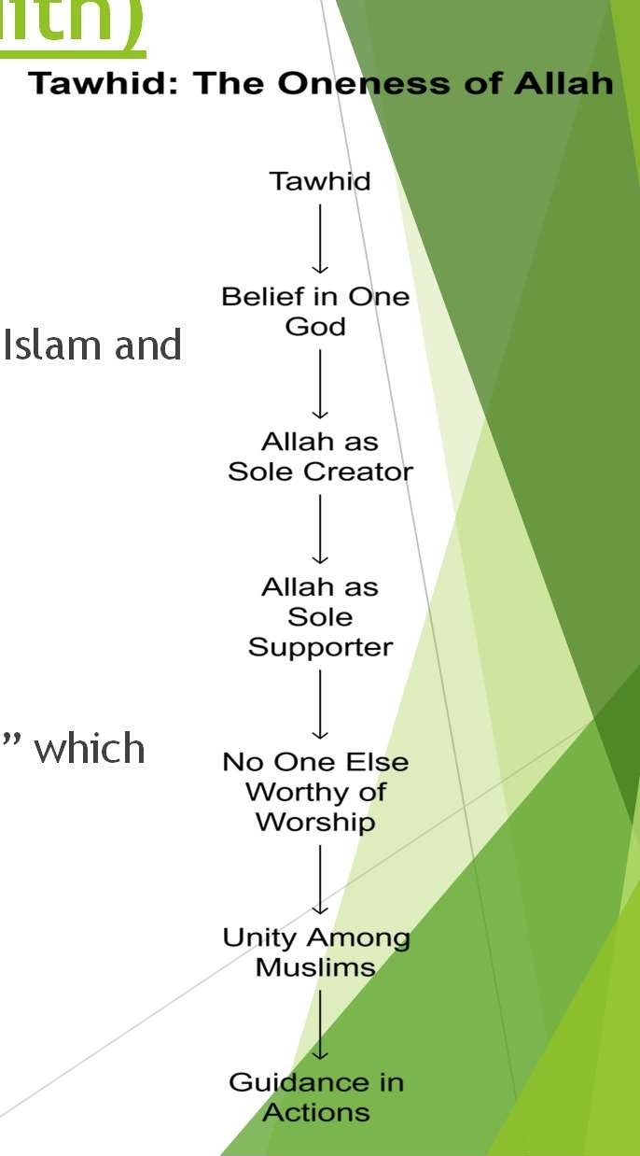
Concept Of Tawhid – (Quran & Had
ith)
Islam and
” which
What is Tawheed? (Concept of Oneness of Allah) Tawheed means believing in one, unique God, Allah.
Allah is the sole Creator, Sustainer, and Ruler. This belief is the core of the basis of all worship.
Quran:
“There is no god but Allah” (Quran 47:19).
“Say, 'He is Allah, the One'” (Surah Ikhlas, 112:1).
“And your god is one God...” (Quran 2:163)
Hadith:
The Prophet (pbuh) taught, “I testify that there is no god but Allah... forms the basis of the Shahada.

Slide 10

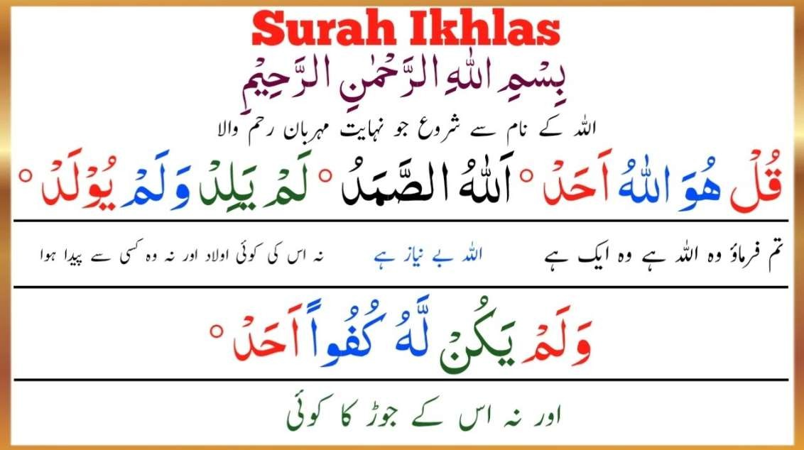
Tawheed According to Surah Ikhlas
Surah Ikhlas (112) Explained:
Verse 1: “Say, ‘He is Allah, the One’” – Affirms His oneness.
Verse 2: “Allah, the Self-Sufficient…” – Only He is worthy of worship.
Verse 3: “He neither begets nor is He begotten” – Rejects any idea of offspring.
Verse 4: “And none is equal to Him” – No one shares His perfection.
This short Surah sums up the essence of Tawheed.
10

Slide 11
Categories of Tawhid
There are 3 types of Tawhid:
Tawhid al-Rububiyyah (Lordship) Allah is the only Creator and Controller.
Tawhid al- Uluhiyyah (Worship) - Only Allah deserves our worship.
Tawhid al-Asma wa as-Sifat (Names & Attributes) - Allah has unique, perfect names and qualities.
There is nothing like unto Him” (Quran 42:11).
Allah is completely unique and different from everything else.
These categories help us understand Allah’s complete uniqueness.

Slide 12
Types of Shirk (Polytheism)
Shirk means directing worship to others besides Allah.
Major Shirk (worshiping other gods)
Quran: “Indeed, Allah does not forgive association with Him...” (Quran 4:48).
Minor Shirk (showing off in worship)
Showing off in acts of worship to gain praise from people instead of pleasing Allah
Hidden Shirk (relying on others instead of Allah)
Relying on created things—like wealth, status, or personal ability—instead of trusting solely in Allah.
Shirk is a severe sin in Islam.
Avoiding all forms of shirk is essential for maintaining pure faith and a sincere relationship with Allah.

Slide 13
The Moral Impact of Tawheed
Tawheed teaches us to be kind, honest, fair, and caring. It reminds us that Allah knows
everything we do and think. This belief encourages us to always do good, treat people nicely, and stay strong in our faith. By following Tawheed, we try to follow the great example of Prophet Muhammad (PBUH) and his companions, who showed kindness, honesty, and goodness in all parts of their lives.

Slide 14
Importance of Tawheed
◆ Foundation of Islam:
It is the core of our faith and identity as Muslims.
◆ Key to Salvation:
Belief in one God is essential for salvation.
◆ Protection Against Shirk:
Prevents associating partners with Allah.
◆ Unity:
Unites Muslims worldwide in a common belief.
The Prophet (pbuh) always stressed that worship must be directed only to Allah.

Slide 15
Belief in Angels
◆ Topics:
◆ Concept of Angels
◆ Angels in (Quran & Hadith)
◆ Categories of angels
◆ Characteristics of Angels
◆ Roles of Angels

Slide 16
What Are Angels?
Angels are special, invisible beings created by Allah from light. They do not have free will like humans they only follow Allah’s commands without question.
Their purpose is to serve Allah by performing various tasks like delivering messages, protecting people, recording deeds, and worshiping Allah continuously.
Angels are pure, obedient, and always do what Allah asks them to do.

Slide 17
Angels in (Quran & Hadith)
Quran Verse:
“And whoever disbelieves in Allah, His Angels, His Books, His Messengers, and the Last Day has certainly gone far astray.”
(Quran 4:136)
Explanation: This verse shows that belief in angels is a core part of the Islamic faith. It reminds us that angels play an essential role in Allah’s plan.
Hadith:
The Prophet Muhammad (PBUH) said, “Angels are created from light.”
(Sahih Muslim)
Explanation: This hadith highlights the unique, pure nature of angels. It teaches us that angels are special beings whose sole purpose is to obey Allah, deliver His messages, and record our deeds.

Slide 18
Categories of angels in Islam – Archangels (Malaika il-Ikram)
◆ Jibril (Gabriel):
Delivers Allah’s messages to the prophets.
Brought the Quran to Prophet Muhammad (PBUH).
◆ Mikail (Michael):
Provides sustenance and controls natural forces (rain, wind).
◆ Izrail (Azrael):
Angel of death; takes souls at the time of death,
◆ Israfil(Raphael):
Will blow the trumpet on the Day of Judgment.

Slide 19
Categories of Angels - Other Groups
◆ Recording Angels:
Write down each person’s good and bad deeds. (Quran 82:10-12)
◆ Guardian Angels:
Protect and watch over individuals. They help maintain safety and order.
◆ Munkar and Nakeer:
Question the dead in the grave about their faith.
◆ Punishment Angels:
Execute Allah’s punishment when needed. (Quran 96:18)
◆ Angels of Mercy/Resurrection/Paradise:
Bring blessings, assist on Judgment Day, welcome believers to Paradise.
Example: Hadrat Ridwan (guard of Paradise).

Slide 20
Characteristics of Angels
◆ Created from Light:
(Quran 81:1)
◆ Invisible to Humans:
(Quran 6:50)
◆ Always Obey Allah:
(Quran 66:6)
◆ No Free Will:
(Quran 16:50)
◆ No Gender or Human Desires:
(Quran 53:27)
20

Slide 21
Roles of Angels
◆ Convey Revelations:
Example: Jibril delivers Allah’s messages to prophets.
◆ Protect Believers:
Guard and assist us during difficult times.
◆ Record Deeds:
Remind us that every action is noted (Quran 82:10-12).
◆ Execute Punishment:
Carry out Allah’s commands when needed.
◆ Assist on Judgment Day:
Help with the final reckoning (Quran 25:25).

Slide 22
Number of Angels and Continuous Creation
◆ Daily Creation:
Hadith (Sunan-e-Tirmidhi) mentions 70,000 to 80,000 angels are created daily.
◆ Vast Numbers:
600 wings around Allah’s Throne (Bukhari); millions guarding Hellfire (Sahih Muslim).
◆ Continuous Creation:
Allah’s creative power is endless, showing His boundless majesty.

Slide 23
Bayt al-Ma'mur and Angelic Tawaf
◆ Bayt al-Ma'mur:
Known as the "Heavenly Kaaba," located above the Kaaba in the seventh heaven.
◆ Angelic Tawaf:
A Hadith in Sahih Bukhari states that 70,000 angels enter Bayt al-Ma'mur daily to perform tawaf (circumambulation).
◆ Impact:
Demonstrates the continuous and organized worship in the heavens.
An endless, divine ritual of worship that never stops.

Slide 24
Believe in Divine Books
◆ Topics:
◆ What is Divine Revelation
◆ Requirements for Believing in Divine Books
◆ Impact of Belief in Holy Books (Quran & Hadith)
◆ The Four Major Holy Books
◆ Additional Scriptures – Suhuf/Scrolls

Slide 25
What is Divine Revelation
Divine guidance is given by Allah through revelations.
These messages come in the form of holy books and smaller scriptures called Suhuf.
They serve as the foundation for our morals, social behavior, and ethics.
Example: The Quran teaches us to be honest, fair, and kind, guiding millions to live good, righteous lives.

Slide 26
Requirements for Believing in Divine Books
Acceptance:
Believe that all holy scriptures are true and come from Allah.
Quran Example: “Believe in what has been revealed to you…” (Quran 2:136).
Respect:
Treat the words of Allah with great honor and care.
Hadith Example: The Prophet (PBUH) taught us to hold the Quran in the highest regard.
Implementation:
Follow and practice the guidance and teachings found in these books.
Sahaba Example: The companions learned and lived by the Quran every day.

Slide 27
Impact of Belief in Holy Books (Quran & Hadith)
Guidance for Life:
Holy books give clear rules for justice and kindness.
Quran Example: “And establish prayer and give zakah…” (Quran 2:43) teaches us to support our community.
Hadith Example: The Prophet (PBUH) said, “Actions are judged by intentions,” which
guides us to act sincerely.
Unity Among Muslims:
A shared belief in divine revelations brings Muslims together.
Quran Example: “Hold firmly to the rope of Allah…” (Quran 3:103) reminds us to stay united.
Sahaba Example: The companions, like Hazrat Umar (RA), worked together and
supported one another.
Moral Foundation:
Holy books encourage us to be honest, just, and kind.
Quran Example: “Indeed, Allah commands justice…” (Quran 16:90) teaches us to be fair and compassionate.
Hadith Example: The Prophet (PBUH) said, “The best of you are those who are best
to their neighbors,” inspiring ethical behavior.

Slide 28
The Four Major Holy Books
◆ The Quran: Final and unaltered word of Allah revealed to Hazrat Muhammad (PBUH).
◆ Torah (Tawrat): Given to Prophet Moses.
◆ Gospel (Injil): Given to Prophet Jesus.
◆ Psalms (Zabur): Given to Prophet David.

Slide 29
Additional Scriptures – Suhuf/Scrolls
Suhuf (Scrolls/Booklets):
Smaller revelations given to earlier prophets.
Additional scriptures revealed to earlier prophets. Examples include:
Scrolls of Abraham (Suhuf Ibrahim)
Scrolls of Moses (Suhuf Musa)
Scrolls of Adam (Suhuf Adam)
Sahifa of Prophet Noah, Hud, Salih, Shuaib, and Idris
These scriptures add to the divine guidance provided over time.

Slide 30
Articles of Faith, Prophethood, Judgment, Destiny, & Resurrection
◆ Course Outline Includes:
◆ Pillars of Islam
◆ Holy Quran
◆ Islam and Science
◆ Learning Outcomes:
◆ Understand and explain fundamental beliefs and systems of Islam.
◆ Value Islam based on the efforts of the Prophet and early Muslims.
◆ Adapt ethical and moral values from Quranic verses and Hadith.
30

Slide 31
Belief in Prophets and Messengers
◆ Topics:
◆ Nabi (Prophet) and Rasool (Messenger)
◆ The Ulul Azm Prophets (The Five Ulul Azm Prophets)
◆ Attributes & Qualities of Prophets
◆ Inspiration from the Prophets Character
◆ Outstanding Characteristics of the Prophet (PBUH)
◆ Finality of Prophethood (Khatm an-Nubuwwah)

Slide 32
Nabi (Prophet) and Rasool (Messenger)
Nabi (Prophet):
Receives revelations via an angel (usually Jibril).
Guides his community using Allah’s message.
Rasool (Messenger):
Brings a new (Shariah) scripture and law.
Establishes a new religious community based on Allah’s message.
Key Differences:
Nabi follows existing law; Rasool establishes new law.
Rasool’s message is broader and community-changing.
Key Point: Every Rasool is a Nabi, but not every Nabi is a Rasool.

Slide 33
The Ulul Azm Prophets
◆ Who Are They? These prophets are very determined and patient. They faced big challenges with strong, unshakable faith.
◆ The Five Ulul Azm Prophets:
Prophet Noah (AS):
preached to his people for a very long time, telling them to worship only Allah His people mostly refused built a huge ark because Allah commanded him to save the believers. Even though people laughed at him, he trusted Allah completely. When the great flood came, his ark saved him and those who believed.
Prophet Ibrahim (AS):
Hazrat Ibrahim (AS) also preached against idol worship. He faced many challenges, including being thrown into a fire, but Allah saved him. He is known for his strong faith and willingness to obey Allah commands, even when they seemed very difficult, such as the command to sacrifice his son. Abraham is considered the father of many prophets.
Prophet Musa (AS):
Led his people out of Egypt, overcoming oppression.
Despite facing a powerful Pharaoh, he guided the Israelites to freedom by following Allah's command.
Prophet Isa (AS):
Performed miracles and spread a message of compassion.
He healed the sick and showed kindness, reminding people to care for one another.
Prophet Muhammad (SAW):
Muhammad (SAW) is the final prophet in Islam. He received the Quran from God. He faced many hardships while spreading the message of Islam.
Hazrat Muhammad (SAW) is known for his exemplary character, and for the completion of Allah message to mankind.
Their strength shows us the value of persistence and patience.
T^{M}h^{s} e^{Sa}y^{fia}in^{W}s^{aq}pªi^{s}r⁻e^{Sp}u^{ri}s^{ng}t²o⁰²⁵st^{Is}a^{la}n^{m}d^{ic S}s^{t}t^{u}r^{d}o^{ie}n^{s /}g^{E}i^{t}n^{hic}o^{al}u^{B}r^{eh}b^{av}e^{io}l^{u}i^{r}efs and act with courage and integrity.
Their lives serve as simple examples of how to overcome challenges ethically and with faith.
33

Slide 34
Attributes & Qualities of Prophets
◆ Core Qualities:
Truthfulness (Sidq): Always honest and trustworthy.
Trustworthiness (Amanah): Safeguard divine messages.
Wisdom (Fatanah): Shows deep understanding and insight.
Infallibility (Ismah): Free from major sins; ideal role models.
Patience (Sabr): Steadfast under trials.
Justice (‘Adl): Fair and equitable in all dealings.
Humility (Tawadu’): Modest despite high status.
Courage (Shaja’ah): Bold in confronting injustice and facing challenges.
Ms Safia Waqas - Spring 2025 Islamic Studies / Ethical Behaviour
34

Slide 35
Inspiration from the Prophets Character
Role Models for Good Behavior:
Prophets show us how to act with kindness and fairness.
Prophet Muhammad (pbuh) treated everyone with respect, even those who disagreed with him.
Promote Honesty and Trust:
Their words and actions teach us to always be truthful and keep our promises.
Encourage Justice:
They stand up for what is right and ensure everyone is treated fairly.
Inspire Compassion and Patience:
Prophets show us how to care for others and remain calm in hard times.
Guide to a Balanced Life:
Their example helps us balance work, worship, and family responsibilities.
Ms Safia Waqas - Spring 2025 Islamic Studies / Ethical Behaviour 35
Example: managing, prayer, and family time so that no part of life is neglected.

Slide 36
Outstanding Characteristics of the Prophet (PBUH)
Seal of Prophethood (Khatam-un-Nabiyyin) :
Final prophet; his message is complete.
Mercy to All Worlds (Rahmat-ul-lil-Alameen) :
Sent as a mercy for all creation.
Exemplary Character (Uswah Hasanah):
Perfect social, spiritual, and moral conduct.
Balanced Leadership:
Combines justice with compassion.
Direct Communication with Allah:
Experienced Isra and Mi’raj (Night Journey).
Universality:
Ms Safia Waqas - Spring 2025 Islamic Studies / Ethical Behaviour
Message for all mankind and jinn.
36

Slide 37
Finality of Prophethood (Khatm an-Nubuwwah)
◆ Belief: Prophet Muhammad (pbuh) is the last prophet.
◆ Quranic evidence: “...he is the Messenger of Allah and the Seal of the Prophets.” (33:40)
◆ Hadith Evidence: “There will be no prophet after me.” (Sahih Muslim)
◆ Consensus (Ijma’): Muslim community agrees on the finality of his prophethood.
◆ Ethical Implication: Provides complete and unchanging guidance for life.

Slide 38
Belief in the Day of Judgment
◆ Topics:
◆ Judgment Day: When Everyone is held Accountable & Concept of the Day of Judgment
◆ Stages and Signs of the Day of Judgment
◆ The Trumpet (Sur) (First Blowing) and (Second First Blowing)
◆ Stages of the Day of Judgment
◆ Signs of the Day of Judgment
◆ Names of the Day of Judgment (Qiyamah)

Slide 39
Judgment Day: When Everyone is Held Accountable
◆ Day of Judgment: The Day of Judgment (Qiyamah or Yawm al-Din) is a fundamental concept in Islam
◆ Concept of the Day of Judgment:
Resurrection: Bodies and souls are revived. Allah will resurrect all humans and jinn, restoring their physical bodies.
Gathering: All creatures meet before Allah.
Accountability: Individuals will be judged based on deeds, intentions, and faith.. Reward & Punishment: The righteous will enter Paradise (Jannah), while the wicked will be consigned to Hell (Jahannam).
◆ Quranic Reminder: “Every soul shall taste death…” (29:57)

Slide 40
The Trumpet (Sur)
The Day of Judgment will be initiated by the blowing of the trumpet (Sur) by the angel Israfil.
Two blowing's are mentioned according to the Quran and Hadith.
First Blowing
Nafkhatu’l-Faza’ or Nafkhatu’l-Sa’aq (The Blowing of Destruction)
Initiates the destruction of the
heavens and the earth and the death of all living creatures.
Quranic Reference: Surah Az-Zumar, 39:68
Second Blowing
Nafkhatu’l-Ba’th or Nafkhatu’l- Qiyama (The Blowing of Resurrection)
Signals the resurrection of all creatures from their graves.
Quranic Reference: Surah Az-Zumar, 39:68
Hadith Confirmation: Sahih al- Bukhari & Sahih Muslim
40

Slide 41
Stages of the Day of Judgment
Al-Qiyamah (Resurrection). Everyone comes back to life.
Al-Hashr (Gathering). All people are brought together.
Al-Hisab (Accountability). Everyone is judged for their actions.
Al-Mizan (Weighing of Deeds). Good and bad deeds are measured.
Al-Pul Sirat (Crossing the Bridge). Cross a bridge to our final place.
Al-Jannah (Paradise) or Al-Jahannam (Hell). Our final home is decided by our deeds.

Slide 42
Signs of the Day of Judgment
Appearance of the Mahdi: A good leader who will bring justice and help people
Return of Jesus (Hazrat Isa): Jesus(Hazrat Isa) will come back to help defeat evil and bring peace.
Arrival of the Dajjal (Anti-Christ): A false messiah who will spread lies and cause problems.
Rise of the sun from the west: A surprising sign where the sun will rise from the opposite direction.
Collapse of the Kaaba: The holy building in Mecca may fall apart as a sign of the end times.
More Hardships: Life will become very difficult, and people will face many challenges.

Slide 43
Names of the Day of Judgment (Qiyamah)
Names of the Day of Judgment (Qiyamah)" are different words used in the Quran to describe the final day when everyone will be brought back to life and judged by God. Each name tells us something special about that day, like being raised from the dead, being gathered together, and having our good and bad deeds weighed.
Yawn al-Qiyamah – Day of Resurrection
Yawn al-Din – Day of Judgment
Yawn al-Hisab – Day of Reckoning
Yawn al-Mizan – Day of Weighing
Yawn al-Talaq – Day of Gathering
Yawn al-Hashr – Day of Assembly
Yawn al-Nushur – Day of Expulsion
Yawn al-Khulud – Day of Eternity
◆ 9. Yawn al-Azifah – Day of Catastrophe
◆ 10. Yawn al-Ghayb – Day of the Unseen
◆ 11. Yawn al-Waqi’ah – Day of the Event
12. Yawn al-Tanad – Day of Calling
◆ 13. Yawn al-Jam’ – Day of Gathering
◆ 14. Yawn al-Fasl – Day of Separation
◆ 15. Yawn al-Ba’th – Day of Resurrection
16. Yawn al-Rujz – Day of Wrath
◆ 17. Yawn al-Zulm – Day of Darkness

Slide 45
Believe in the Destiny/ Predestination (Taqdeer/Qadar)
Topics:
◆ What is Destiny (Qadr)?
◆ Four Key Aspects of Destiny
◆ Types of Destiny & Fixed vs. Changeable Destiny
◆ Quranic and Hadith References on Destiny

Slide 46
Belief in Destiny/Predestination and Resurrection (Qadr)
What is Destiny (Qadr)?
Destiny (Qadr) means Allah’s plan for everything.
Concept:
Everything happens by Allah’s will and is part of His divine plan. It is a basic belief and one of the six pillars of faith in Islam.
Trust in Allah’s wisdom and justice is at the heart of this belief.

Slide 47
Four Key Aspects of Destiny
Knowledge (Ilm):
Allah knows everything that happened in the past, is happening now, and will happen in the future.
“Indeed, Allah is All-Knowing of all things.” (Surah Al-Anfal, 8:75)
Preserved Tablet (Al-Lawh al-Mahfuz):
Every event is recorded by Allah in a special, unchangeable record.
“Do you not know that Allah knows what is in the heaven and earth? Indeed, this is in a Record...” (Surah Al-Hadid, 57:22)
Allah’s Will (Mashiah):
Nothing occurs unless Allah wills it. Every event happens only because Allah allows it.
“And you do not will except that Allah wills.” (Surah Al-Insan, 76:30)
Creation (Khalq):
Allah is the Creator of everything, including our actions.
“Allah is the Creator of all things...” (Surah Az-Zumar, 39:62)

Slide 48
Types of Destiny
Fixed vs. Changeable Destiny
Immutability:
Mubram: Fixed and cannot be changed.
Muallaq: Can be changed by our actions.
Human Influence:
Muallaq: Affected by our choices, prayers, charity, and good deeds.
Knowledge:
Mubram: Known only to Allah.
Unrevocable Destiny (Mubram): Definition: Allah’s plan that never changes. Key Points:
Only Allah knows these details.
It cannot be changed.
Examples: Time of death, place of birth, who your parents are.
Revocable Destiny (Muallaq):
Definition: A plan that can change with our actions. •Muallaq: Partly known to humans and Allah.
Key Points:
For example, if you study hard, you expect to get good grades, but unexpected events may also affect your results—this shows that while you can see some outcomes, only Allah fully knows the final result.
It depends on our choices.
Our actions can change it.
Example: (marriage, wealth, health).

Slide 49
Quranic and Hadith References on Destiny
Quran Verses:
“And with Him are the keys of the unseen; none knows them except Him…” (Surah Al- An’am, 6:59)
“No disaster strikes upon the earth... except that it is in a register before We bring it into being...” (Surah Al-Hadid, 57:22)
“And We test you with evil and with good as trial...” (Surah Al-Anbiya, 21:35)
Hadith Highlights:
“Faith is to believe in Allah, His angels, His books, His messengers, the Last Day, and to believe in Qadr, both its good and its evil.” (Sahih Muslim)
“Allah wrote down the decrees of creation fifty thousand years before He created the heavens and the earth.” (Sahih Muslim)
“Strive, for everyone will be facilitated to what he is created for.” (Sahih al-Bukhari & Sahih Muslim)
“Nothing increases one’s lifespan except good deeds, and nothing repels divine decree except supplication.” (Jami` at-Tirmidhi)

Slide 50
Believe in Resurrection after death (Rising from the dead)
Topics:
◆ Introduction to Resurrection
◆ Quranic References
◆ Types of Resurrection
◆ Categories of Resurrection
◆ Quran & Hadith References
◆ Stages of Resurrection
◆ Resurrection in Surah Al-Baqarah (Verses 259 & 260)
50

Slide 51
Introduction to Resurrection
Definition: Resurrection (Ba‘th) is the revival of souls and bodies after death.
Purpose: For judgment and accountability on the Day of Judgment.
Key Idea: Death is not the end; life continues with a final judgment
51

Slide 52
Quran & Hadith References
Quran:
“And the Trumpet will be blown, and all who are in the heavens and all who are on earth will be terrified.” (Quran 17:71)
“And We have recorded everything in a clear register.” (Quran 36:12)
“And We have created everything with Qadr (measure).” (Quran 54:49)
Hadith:
“You will be resurrected with your bodies and wealth.” (Sahih Bukhari)
“The resurrection will be on the Day of Judgment.” (Sahih Muslim)

Slide 53
Types of Resurrection
◆ Minor Resurrection (Al-Ba'th al-Saghir):
Resurrection of the soul after death, returning it to Barzakh (the intermediate state).
◆ Major Resurrection (Al-Ba'th al-Kabir):
The physical revival of bodies on the Day of Judgment.

Slide 54
Categories of Resurrection
◆ Al-Hashr (Gathering):
All creatures are gathered before Allah.
◆ Al-Mahshar (Gathering Place):
The place where everyone is assembled.
◆ Al-Hisab (Accountability):
The process where each person’s deeds are judged.

Slide 55
Stages of Resurrection
Death (Mawt):
The soul leaves the body.
Intermediate Realm (Barzakh):
The soul stays in a temporary place.
Resurrection (Ba‘th):
Souls and bodies are brought back to life.
Gathering (Hashr):
All are assembled before Allah.Judgment
(Hisab):
Every deed is weighed and judged.

Slide 56
Resurrection in Surah Al-Baqarah (Verses 259 & 260)
◆ Verse 259:
A man passed a ruined town and wondered, “How will Allah bring this to life after its death?”
Allah caused him to die for 100 years and then brought him back, showing that even decayed bones can be reassembled.
This verse shows that Allah can make dead things come to life, as He did by bringing a man back after 100 years in a ruined town.
◆ Verse 260:
Prophet Ibrahim asked Allah to show how He gives life to the dead.
Allah demonstrated this by reviving four birds, proving His power and wisdom.
In this verse, Prophet Ibrahim asked Allah to show how He can make the dead live again, and Allah proved it by reviving four birds.
Tafsir Commentary (Ibn Kathir’s Insights):
According to Ibn Kathir, these verses show that Allah has the power to bring the dead back to life.
The story of Ibrahim highlights that asking questions to strengthen one’s heart and faith is important.

